Slide 1
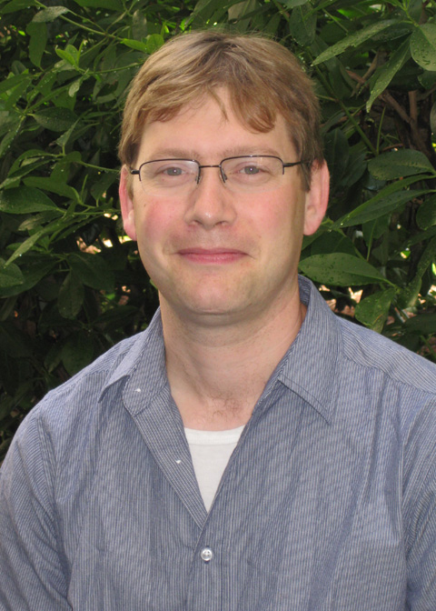
Measuring Behavior Across Scales
Yerkes National Primate Research Center
Behavioral Neuroscience and Psychiatric Disorders
The Center for Translational Social Neuroscience
and
The Silvio O. Conte Center
Present:
Gordon Berman PhD
November 22, 2020 AT 2:00PM
Join Zoom Meeting
https://zoom.us/j/2400347722
Meeting ID: 240 034 7722
One tap mobile
+14702509358,2400347722# US (Atlanta)
+14703812552, 2400347722# US (Atlanta)

